Slide 1

R for Researchers Data Analysis and Visualization Er. Shirish Maharjan Shirish.Maharjan@herdint.com Senior Data Analyst Herd International

Slide 2
Outline
Introduction
Help System
Variables
R environment
Vectors
Matrices
Datasets (data frames)
Lists
Data Visualization using ggplot2
Online Resources

Slide 3
Introduction
Open source programming language for statistical computing and graphics
Part of GNU project
Written primarily in C and Fortran.
Available for various operating systems: Unix/Linux, Windows, Mac
Can be downloaded and installed from http://cran.r-project.org/
R Studio download : Download RStudio - Posit

Slide 4
Advantages
Easy to install. Ready to use in a few minutes.
A few thousand supplemental packages
Open source with a large support community: easy to find help!
Many books, blogs, tutorials.
Frequent updates, Powerful Visualization
More popular than major statistics packages (SAS, Stata, SPSS etc.)
Build for DATA

Slide 5
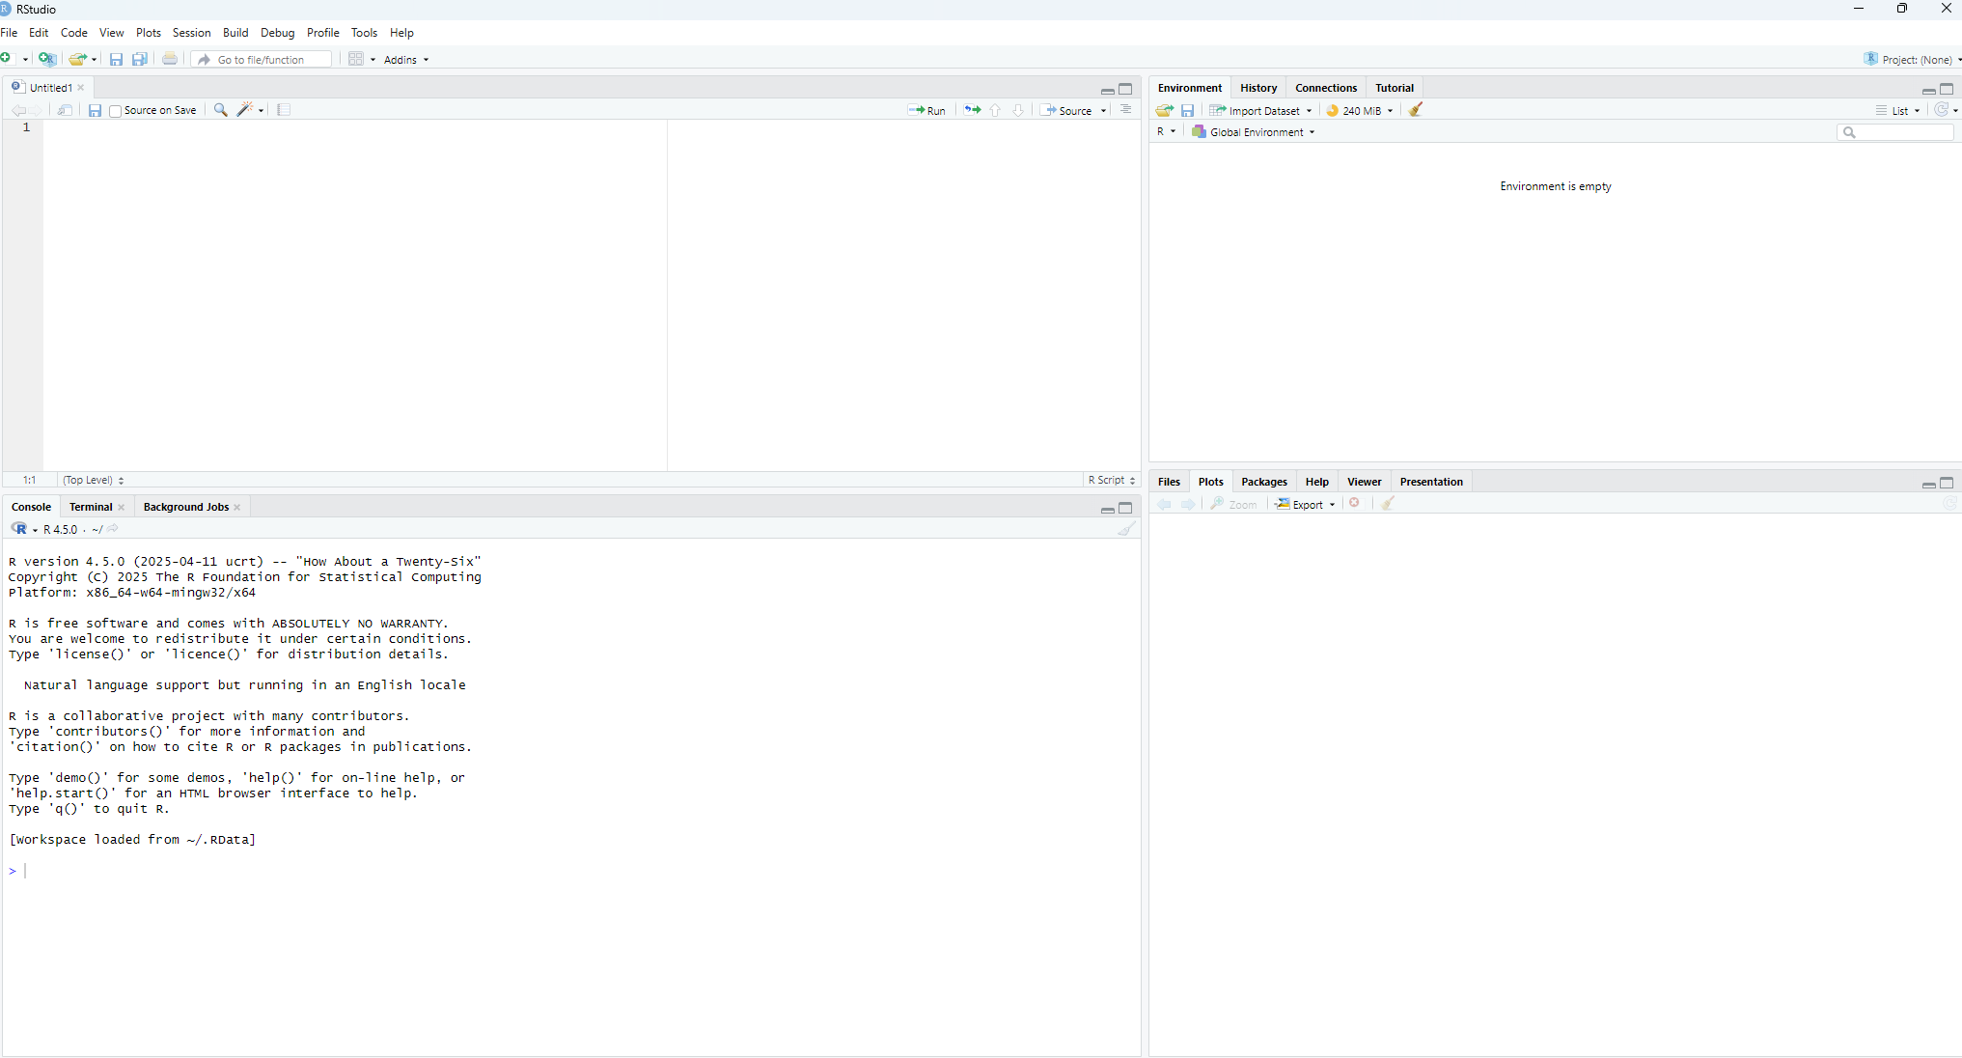
Getting Started

Slide 6
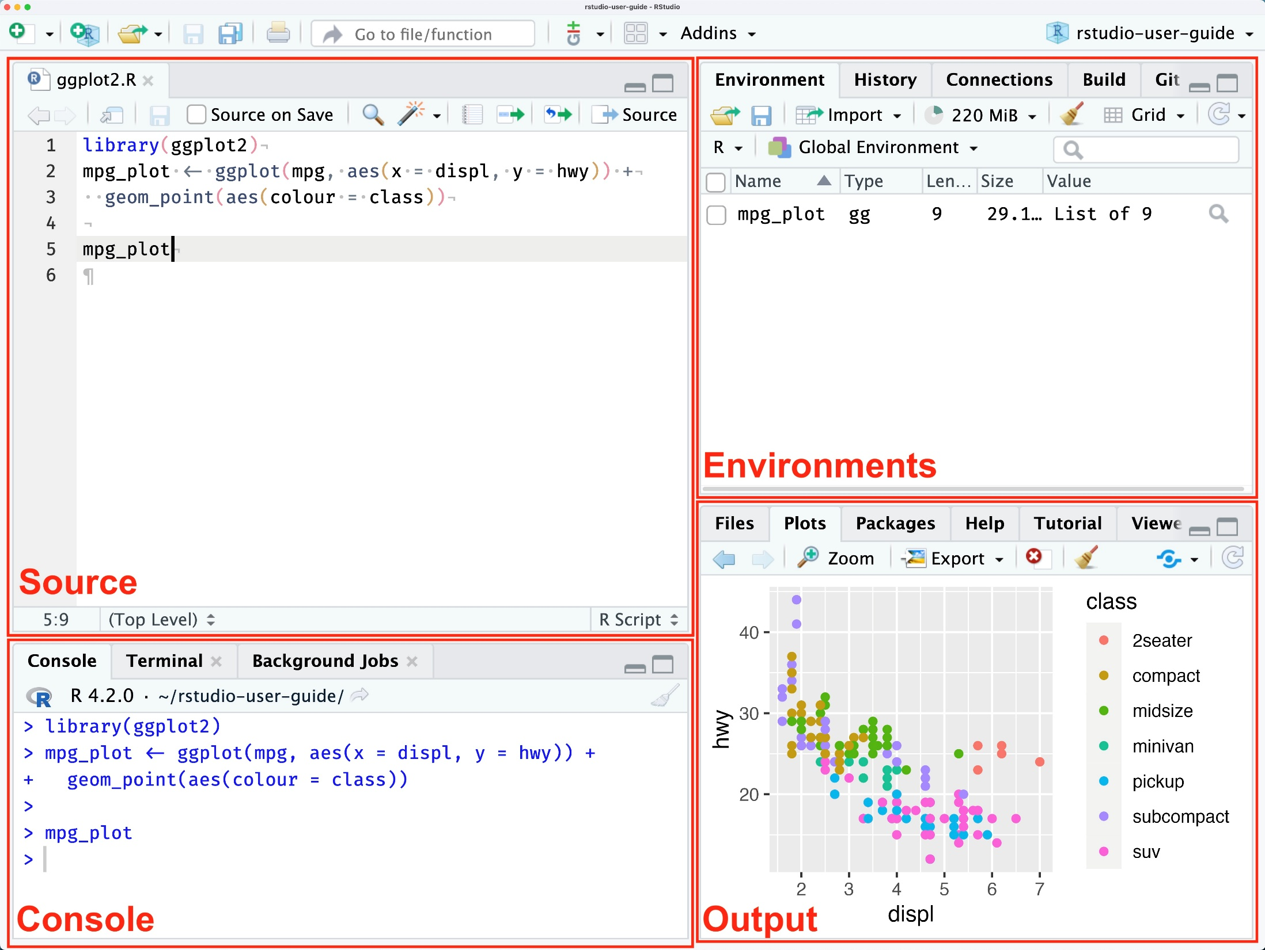

Slide 7
Introduction to R and RStudio
R is the engine: The underlying programming language.
RStudio is the dashboard: An Integrated Development Environment (IDE) that makes using R much easier.
The 4 Panes:
Source Editor (Top-Left): Where you write and save your R scripts (.R files). This is your lab notebook.
Console (Bottom-Left): Where the code actually runs. You can type commands directly here.
Environment/History (Top-Right): View all active objects (data, variables) in your workspace.
Files/Plots/Packages (Bottom-Right): View files, see your plots, install packages, and access help.

Slide 8
R as a calculator
system prompt
User’s input
Text following # sign is a comment
> 7 + 5 # arithmetic operations
[1] 12
Answer
Number of output elements

Slide 9
R as a calculator
system prompt
Incomplete expression
> 7 -
+ 4
[1] 3
answer
Plus sign appears to prompt for continuation of the input expression

Slide 10
R as a calculator
> 7 + 5 # arithmetic operations
[1] 12
> 6 – 3 * ( 8/2 – 1 )
[1] -3
> log(10) # commonly used functions
[1] 2.302585
> exp(7)
[1] 1096.633
> sqrt(2)
[1] 1.414214

Slide 11
Math functions
sqrt(x), sum(x), sign(x), abs(x), …
# trigonometric
sin(x), cos(x), tan(x), asin(x), acos(x), …
# hyperbolic
sinh(x), cosh(x), …
# logarithmic and exponent
log(x), log10(x), log2(x) or log(x, base=10), exp(x)
# factorial and combination functions
factorial(n) , choose(n ,m)
# built-in constants
T, F, pi, LETTERS, letters, month.abb, month.name

Slide 12
Logical operations
Symbol Meaning
! logical NOT
& logical AND
| logical OR
< less than
<= less than or equal to
> greater than
>= greater than or equal to
== logical equals
! = not equal

Slide 13
Operations in R
# A few operations can be listed on one line.
# Use semicolon(;) to separate them
> cos(0); sqrt(2)
[1] 1
[1] 1.414214

Slide 14
getting Help
> # get help on function read.table()
> ?read.table
or
> help(read.table)
> help.start() # help in html format
> # find all functions related to the subject of interest
> help.search("data input")

Slide 15
variables
Assignment operator is <-
Equal sign ( = ) could be used instead, but <- operator is preferred
> x <- 5 # assign value 5 to a variable
> x # print value of x
[1] 5
> x <- 4; y <- 3 # semicolon can be used as a separator
> z <- x*x – y*y # assign the result to a new variable

Slide 16
variables
Caution: Be careful comparing a variable with a negative number!
> x <- -5 # assign value -5 to a variable
> # Wrong evaluation :
> x <-3 # Desired : Is x less than -3
> x
[1] 3

Slide 17
variables
Caution: Be careful comparing a variable with a negative number!
> x <- -5 # assign value -5 to a variable
> # Correct evaluation (use space!):
> x < -3 # Is x less than -3
[1] TRUE
> # Even better (use parenthesis):
> x <(-7) # Is x less than -7
[1] FALSE

Slide 18
variables
-> can also be used as an assignment operator
Objects can take values Inf, -Inf, NaN (not a number)
and NA (not available) for missing data
> 5 -> a # assign value 5 to a variable
> a
[1] 5
> a <- NA # assign “missing data” value to a variable
> a
[1] NA

Slide 19
variables
Names of the objects may contain any combinations of letters, numbers and dots ( . )
> sept14.2012.num <- 1000 # correct!
>

Slide 20
variables
Names of the objects may contain any combinations of letters, numbers and dots ( . )
Names of the objects may NOT start with a number
> 2012.sept14.num <- 1000 # wrong!
Error: unexpected symbol in " 2012.sept14.num"

Slide 21
variables
Names of the objects may contain any combinations of letters, numbers and dots ( . )
Names of the objects may NOT start with a number
Case sensitive
> a <- 5; A <- 7
> a
[1] 5
> A
[1] 7

Slide 22
variables
Names of the objects may contain any combinations of letters, numbers and dots ( . )
Names of the objects may NOT start with a number
Case sensitive
Avoid renaming predefined R objects, constants and functions: c, q, s, t, C, D, F, I, and T
> # examples of correct variable assignments
> b.total <- 21; b.average <- 3
> b.total
[1] 21
> b.average
[1] 3

Slide 23
string variables
Strings are delimited by " or by '.
> myName <- “Shirish"
> myName
[1] “Shirish"
> hisName <- ‘Ram'
> hisName
[1] “Ram"

Slide 24
Data types
There are basic data types:
Integer^{(*)}
Numerical
Complex
Logical (Boolean)
Character string
> int_value <- 21L
> num_value <- 21.69
> cmp_value <- 7 + 3i
> log_value <- ( 2 < 4 )
> str_value <- "Hello R"

Slide 25
Data types
mode() or class():
Note: There is some differences between these functions. See help for more information:
> mode( num_value )
[1] "numeric"
> class( str_value )
[1] "character"
> class( int_value )
[1] "integer"
> mode( int_value )
[1] "numeric"

Slide 26
saving current session
> a <- 5
> b <- a + 3;
> myString <- "apple"
> # list all objects in the current session
> ls()
[1] "a" "b" "myString"
> # save contents of the current workspace into .RData file
> save.image()
> # save contents to the file with a given name
> save.image(file = "myFile.Rdata")
> # save some objects to the file
> save(a,b, file = "ab.Rdata")

Slide 27
loading stored objects
> # load saved session
> load("myFile.Rdata")
> # list all the objects in the current workspace
> ls()
or
> objects()
> # remove objects from the current workspace
> rm(a, b)

Slide 28
other useful commands
> # delete the file (or directory!)
> unlink("myFile.Rdata")
> # get working directory path
> getwd()
> # set working directory path
> setwd( path )

Slide 29
Tips
Use arrow keys ( “up” and “down” ) to traverse through the history of commands.
“Up arrow” – traverse backwards (older commands)
“Down arrow” – traverse forward (newer commands)

Slide 30
data objects overview
Vectors, matrices, data frames & lists
Vector – a set of elements of the same type.
Matrix - a set of elements of the same type organized in rows and columns.
Data Frame - a set of elements organized in rows and columns, where columns can be of different types.
List - a collection of data objects (possibly of different types) – a generalization of a vector.

Slide 31
vectors
Vector : a set of elements of the same type.
2, 3, 7, 5, 1
TRUE, FALSE, FALSE, TRUE, FALSE
"Monday", "Tuesday", "Wednesday", "Thursday", "Friday"

Slide 32
vectors
To create a vector – use function “concatenate” : c( )
> myVec <- c( 1,6,9,2,5 )
> myVec
[1] 1 6 9 2 5
> # lets find out the type of myVec object
> mode(myVec)
[1] "numeric"
> # fill vector with consecutive numbers from 5 to 9 and print it
> print(a<- c( 5:9 ))
[1] 5 6 7 8 9

Slide 33
vectors
We can also use function “sequence” : seq( )
> myVec <- seq( -1.1, 0.5, by=0.2 )
> myVec
[1] -1.1 -0.9 -0.7 -0.5 -0.3 -0.1 0.1 0.3 0.5
Or function “repeat” : rep( )
> myVec <- rep( 7, 3)
> myVec
[1] 7 7 7

Slide 34
vectors
What can we do with vectors?
> # create more vectors:
> a <- c( 1, 2, 4 )
> b <- c( 7, 3 )
> ab <- c( a, b )
> ab
[1] 1 2 4 7 3
> # append more values
> ab[6:10] <- c( 0, 6, 4, 1, 9)

Slide 35
vectors
Accessing vector data (partial list)
x[n] n^{th} element
x[-n] all but n^{th} element
x[1:n] first n elements
x[-(1:n)] elements starting from n+1
x[c(1,3,6)] specific elements
x[x>3 & x<7] all element greater than 3 and less than 7
x[x<3 | x>7] all element less than 3 or greater than 7
length(x) vector length
which(x == max(x)) which indices are largest

Slide 36
vectors
Math with vectors (partial list)
Any math function used for scalars:
sqrt, sin, cos, tan, asin, acos, atan, log, exp etc.
Standard vector functions:
max(x), min(x), range(x)
sum(x), prod(x) # sum and product of elements
mean(x) , median(x) # mean and median values of vector
var(x), sd (x) # variance and standard deviation
IQR(x) # interquartile range

Slide 37
vectors
Additional functions of interest:
> # cumulative maximum and minimum
> x <- c( 12, 14, 11, 13, 15, 12, 10, 17, 13, 9, 19)
> cummax(x) # running (cumulative) maximum
[1] 12 14 14 14 15 15 15 17 17 17 19
> cummin(x) # running (cumulative) minimum
[1] 12 12 11 11 11 11 10 10 10 9 9
> # repetitions of a value
> rep("yes", 5 )
[1] "yes" "yes" "yes" "yes" "yes"
> gender <- c( rep("male", 3 ), rep("female",2) )

Slide 38
vectors
Handling of missing data:
> # Sometimes data are not available
> v <- c( 3, 2, NA, 7, 1, NA, 5)
> # in some cases we might want to replace them with some other value
> v[is.na(v)] <- 0 # replace missing data with zeros
> # the following will not work:
> v[ v == NA ] <- 0
> v == NA # v is unchanged because all the elements of v==NA evaluate to NA
[1] NA NA NA NA NA NA NA

Slide 39
vectors
Operations with vectors of different length:
> x <- c(2, 3, 4, 8)
> y <- c(1, 2, 3)
> r1 <- x + y
Warning message:
In x + y : longer object length is not a multiple of shorter object length
> r1
[1] 3 5 7 9

Slide 40
vectors
Useful vector operations:
sort(x) returns sorted vector (in increasing order)
rev(x) reverses the order of elements
unique(x) returns the vector of unique elements
duplicate(x) returns the logical vector indicating non-unique elements

Slide 41
vectors
Useful vector operations (handling of missing values) :
is.na(x) returns the logical vector indicating missing elements
na.omit(x) suppress observations with missing data
sum(is.na(x)) get the number of missing elements
which(is.na(x)) get indices of the missing elements in a vector
mean( x, na.rm=TRUE ) calculate mean of all non-missing elements
x[is.na(x)] <- 0 replace all missing elements with zeros

Slide 42
vectors
Named vector elements :
# define a vector
> v <- c(“Shirish", “Maharjan")
> v
[1] " Shirish " " Maharjan"
# provide names of vector’s elements
> names(v) <- c("first", "last")
> v
first last
[1] " Shirish " " Maharjan"

Slide 43
matrices
Matrix : a set of elements of the same type organized in rows and columns.
2 3 7 5 1 TRUE FALSE FALSE
7 9 1 4 0 FALSE TRUE FALSE
8 2 6 3 7 FALSE FALSE TRUE

Slide 44
matrices
Matrices are very similar to vectors. The data (of the same type) organized in rows and columns.
There are a few way to create a matrix
Using matrix( data, nrow, ncol, byrow ) function:
> mat <- matrix(seq(1:21) ,nrow = 7)
> mat
[,1] [,2] [,3]
[1,] 1 8 15
[2,] 2 9 16
[3,] 3 10 17
[4,] 4 11 18
[5,] 5 12 19
[6,] 6 13 20
[7,] 7 14 21

Slide 45
matrices
To find dimensions of a matrix, use dim() function:
> dmat <- diag(5)
> dim( dmat)
[1] 5 5
To find the number of rows and columns of a matrix, use nrow() and ncol() respectfully:
> dmat <- matrix(seq(1:21) ,nrow = 7)
> nrow( dmat)
[1] 7
> ncol( dmat)
[1] 3

Slide 46
matrices
Operations with matrices:
> # transpose
> mat <- t(mat)
> mat
[,1] [,2] [,3] [,4] [,5] [,6] [,7]
[1,] 1 4 7 10 13 16 19
[2,] 2 5 8 11 14 17 20
[3,] 3 6 9 12 15 18 21

Slide 47
matrices
Matrix multiplication:
> # matrix’ elements multiplication
> x <- matrix( seq(1:9), nrow=3)
> y <- matrix( seq(1:9), nrow=3, byrow=TRUE)
> (x * y)
[,1] [,2] [,3]
[1,] 1 8 21
[2,] 8 25 48
[3,] 21 48 81
> # as with vectors, to perform usual matrix multiplication, use %*%
> (x %*% y)
[,1] [,2] [,3]
[1,] 66 78 90
[2,] 78 93 108
[3,] 90 108 126

Slide 48
matrices
Naming matrix rows and columns
rownames(x) set or retrieve row names of matrix
colnames(x) set or retrieve column names of matrix
dimnames(x) set or retrieve row and column names of matrix
> # define matrix
> x <- matrix(1:6, nrow = 2)
[,1] [,2] [,3]
[1,] 1 3 5
[2,] 2 4 6
> # specify column names:
> colnames(x) <- c("col1" , "col2", "col3")
> # specify both – row and column names:
> dimnames(x) <- list(c("col1" , "col2", "col3"),
+ c("row1" , "row2"))

Slide 49
matrices
Combining vectors and matrices:
> # To stuck 2 vectors or matrices, one below the other, use rbind()
> x <- rbind( c(1,2,3) , c(4,5,6) )
> x
[,1] [,2] [,3]
[1,] 1 2 3
[2,] 4 5 6
> # To stuck 2 vectors or matrices, next to each other, use cbind()
> x <- cbind( c(1,2,3) , c(4,5,6) )
> x
[,1] [,2]
[1,] 1 4
[2,] 2 5
[3,] 3 6

Slide 50
data frames
Data frames are fundamental data type in R
A data frame is a generalization of a matrix
Different columns may have different types of data
All elements of any column must have the same data type
Age Weight Height Gender
18 150 67 F
23 170 70 M
38 160 65 M
52 190 68 F

Slide 51
data frames
We can create data on the fly:
> age <- c( 18, 23, 38, 52)
> weight <- c( 150, 170, 160, 190)
> height <- c( 67, 70, 65, 68)
> gender <- c("F", "M", "M", "F")
> data0 <- data.frame( Age = age, Weight = weight, Height = height,
+ Gender = gender)
> data0
Age Weight Height Gender
1 18 150 67 F
2 23 170 70 M
3 38 160 65 M
4 52 190 68 F

Slide 52
data frames
The data usually come from an external file.
First consider a simple text file : inData.txt
To load such a file, use read.table() function:
> data1 <- read.table(file = "inData.txt", header = TRUE )
> data1
Age Weight Height Gender
1 18 150 67 F
2 23 170 70 M
3 38 160 65 M
4 52 190 68 F

Slide 53
data frames
Often data come in a form of a spreadsheet. To read this into R, first save the data as a CSV file, for example inData.csv.
To load such a file, use read.csv() function:
> data1 <- read.csv(file="inData.csv", header=TRUE, sep=",")
> data1
Age Weight Height Gender
1 18 150 67 F
2 23 170 70 M
3 38 160 65 M
4 52 190 68 F

Slide 54
data frames
The contents of the text file can be displayed using file.show() function.
> file.show("inData.csv")
Age,Weight,Height,Gender
18,150,67,F
23,170,70,M
38,160,65,M
52,190,68,F

Slide 55
data frames
To explore the data frame:
> # get column names
> names(data1)
[1] "Age" "Weight" "Height" "Gender"
> # get row names (sometimes each row is given some name)
> row.names(data1)
[1] "1" "2" "3" "4"
> # to set the rows the names use row.names function
> row.names(data1) <- c(“Ram", “Shyam", “Hari", “Gopal")
> data1
Age Weight Height Gender
Ram 18 150 67 F
Shyam 23 170 70 M
Hari 38 160 65 M
Gopal 52 190 68 F

Slide 56
data frames
To access the data in the data frame:
> # access a single column
> data1$Height
or
> data1[,3]
or
> data1[, "Height"]
or
> data1[[3]] # access the object that is stored in the third list element
[1] 67 70 65 68

Slide 57
data frames
Very convenient function to analyze the data set - summary() :
> summary(data1)
Age Weight Height Gender
Min. :18.00 Min. :150.0 Min. :65.0 F:2
1st Qu.:21.75 1st Qu.:157.5 1st Qu.:66.5 M:2
Median :30.50 Median :165.0 Median :67.5
Mean :32.75 Mean :167.5 Mean :67.5
3rd Qu.:41.50 3rd Qu.:175.0 3rd Qu.:68.5
Max. :52.00 Max. :190.0 Max. :70.0

Slide 58
lists
List: a collection of data objects (possibly of different types) – a generalization of a vector.
4, TRUE , “Ram", 7, FALSE, “Shyam"

Slide 59
lists
A List is a generalized version of a vector. It is similar to struct in C.
> # create an empty list
> li <- list()
> li0 <- list(“Ram", 120, 72, T)
> li0
[[1]]
[1] “Ram"
[[2]]
[1] 120
[[3]]
[1] 72
[[4]]
[1] TRUE
* Notice double brackets to access each element of the list

Slide 60
lists
We can also give names to each element, i.e.:
> # create a list that stores data along with their names:
> li <- list(name = “Ram", weight = 120, height = 72, student = TRUE)
> li
$name
[1] “Ram"
$weight
[1] 120
$height
[1] 72
$student
[1] TRUE

Slide 61
lists
We can add more elements after the list has been created
> li$year <- "freshman"
> # check if the element got into the list:
> li
$name
[1] “Ram"
$weight
[1] 120
$height
[1] 72
$student
[1] TRUE
$year
[1] "freshman"

Slide 62
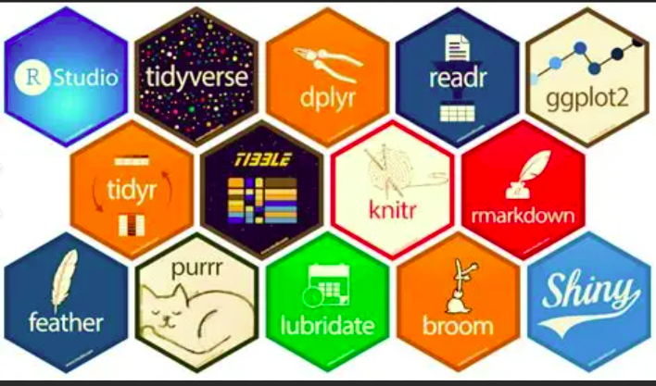
Packages
R packages are collections of functions, data, and compiled code that enhance the functionality of R, allowing users to perform a wide range of tasks from data analysis to visualization.
install.packages("package_name")

Slide 63
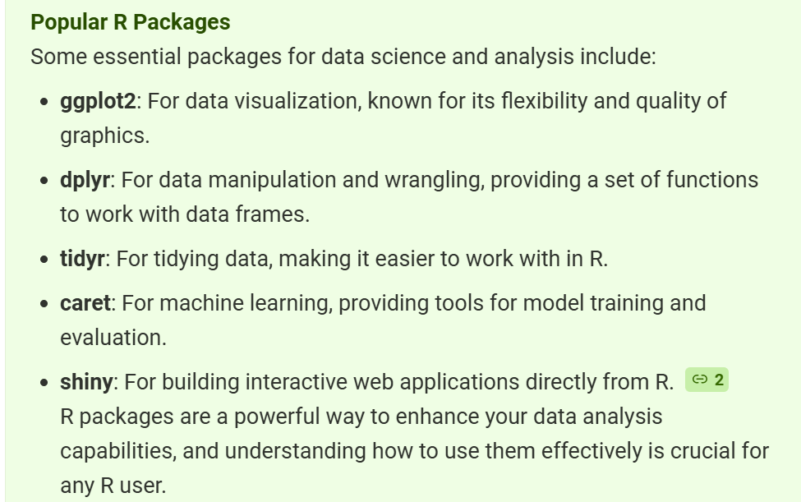

Slide 64
Online Resources
Online Books:
"An introduction to R. Notes on R: A Programming Environment for Data Analysis and Graphics", by W. N. Venables, etc.
"Using R for Introductory Statistics ", by John Verzani.
"R for Beginners", by Emmanuel Paradis.
"The R Guide", W. J. Owen.
"Using R for Data Analysis and Graphics. Introduction, Code and Commentary", by J. H. Maindonald.
Official CRAN R language manuals:
http://cran.r-project.org/manuals.html
Free Online Courses & Code Examples:
http://www.codeschool.com/courses/try-r by Code School
http://www.ats.ucla.edu/stat/ Institute for Digital Research and Education
Many MOOCs courses!

